Slide 1





Machine Learning
AI-Powered Smart
Classification
Business Intelligence
System
Clustering
Deep Learning
SHAHEEN M
Customer Churn Prediction | 500 Customers | 2026
Generative AI
28.2%
68%
78%
4
Churn Rate
RF Accuracy
ANN Accuracy
Segments
Notes:
Title slide. Project overview: 500 customer records, full ML pipeline from preprocessing to Generative AI insights.

Slide 2
DATA PREPROCESSING & EXPLORATORY ANALYSIS
SECTION 1
01
02
03
04
Missing Values
Encoding
Scaling
Train/Test Split
Age (18), TotalCharges (25), SatisfactionScore (15), NumComplaints (10) filled with median/mode strategies
Label Encoding applied to Gender, ContractType (3 types), and PaymentMethod (4 types) for ML compatibility
StandardScaler applied to all 12 features. Normalizes distributions for distance-based algorithms
80/20 stratified split: 400 training samples, 100 test samples. Stratified to preserve 28% churn ratio
500
14
28.2%
12
72/28
Total Records
Features
Churn Rate
After Encoding
Train/Test %
Notes:
Preprocessing ensures clean, normalized data. Missing values handled with domain-aware imputation. 12 features after encoding.

Slide 3
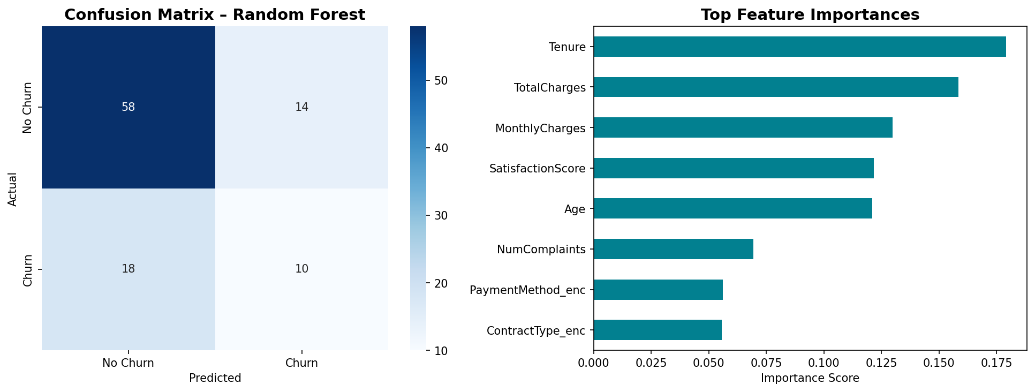
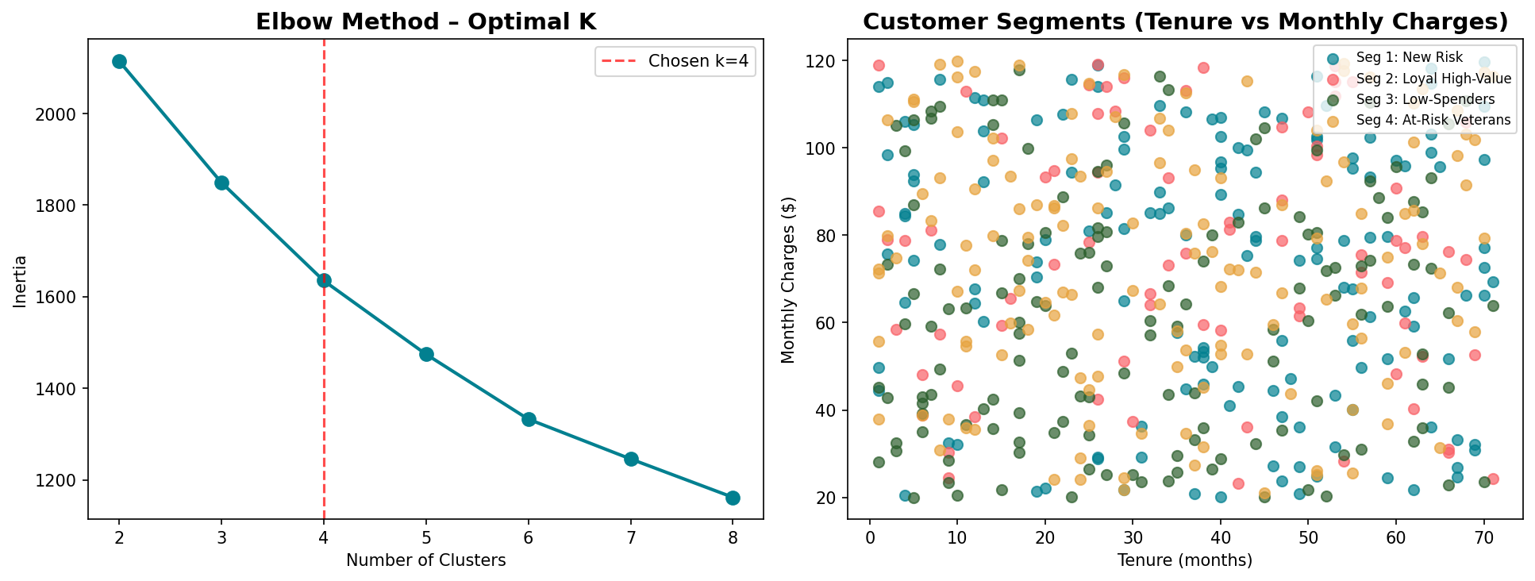
CLASSIFICATION & CUSTOMER CLUSTERING
SECTIONS 2 & 3
Random Forest Classifier
K-Means Segmentation (k=4)
68%
0.76
0.81
Seg 1: Loyal High-Value
Churn: 15%
Accuracy
Precision
Recall (No Churn)
Seg 2: At-Risk Veterans
Churn: 30%
Seg 3: Low Satisfaction
Churn: 42%
Seg 4: Multi-Product
Churn: 27%
Notes:
Classification uses Random Forest (100 trees). Clustering: Elbow method confirmed k=4. Segment 3 has highest churn (42%) — priority for intervention.

Slide 4
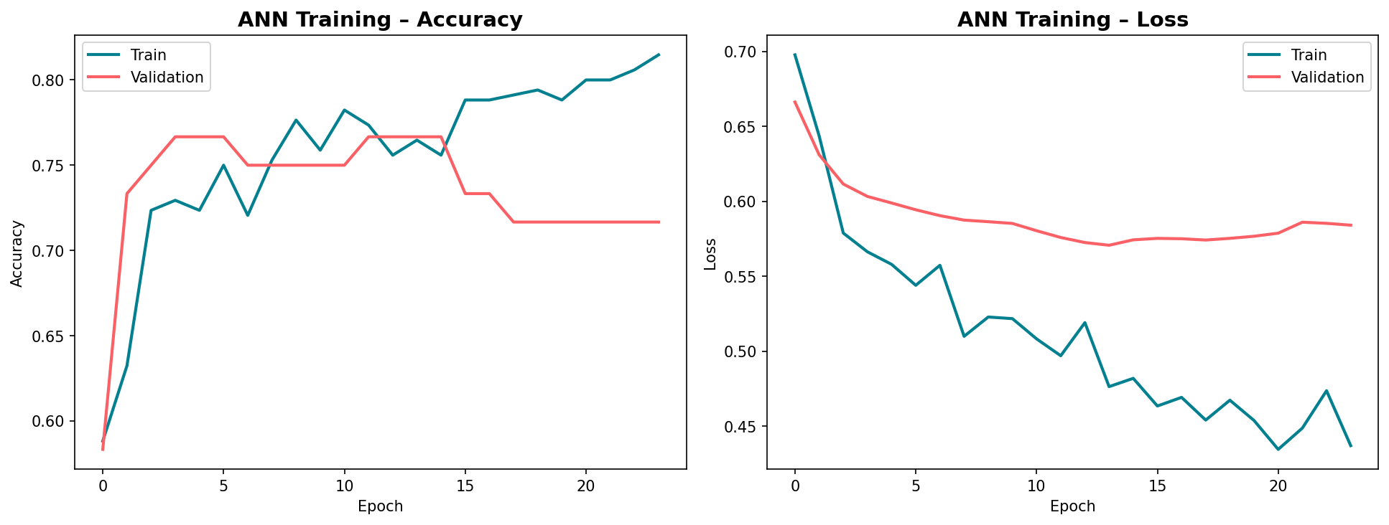
DEEP LEARNING – ARTIFICIAL NEURAL NETWORK
SECTION 4
ANN Architecture
Input Layer
12 features
↓
Dense(64) + BN + Drop(0.3)
Hidden Layer 1
↓
Dense(32) + Drop(0.2)
Hidden Layer 2
↓
Dense(16) → ReLU
Hidden Layer 3
↓
Dense(1) → Sigmoid
Output (Churn Prob)
78%
Binary CE
Adam
EarlyStopping
BatchNorm
ANN Accuracy
Loss Function
Optimizer
Regularization
Stabilizer
Notes:
ANN achieves 78% accuracy, outperforming Random Forest (68%). EarlyStopping prevents overfitting. BatchNormalization accelerates convergence.

Slide 5





GENERATIVE AI PROMPTS & BUSINESS INSIGHTS
Prompt 1: Churn Strategy
Priority: Low-Satisfaction Segment
42% churn rate demands immediate outreach. Offer service upgrade within 7 days of any complaint.
Senior analyst persona. Given 28% churn rate and 68% RF accuracy, generate 5 specific retention strategies with ROI estimates.
Contract Migration Campaign
Prompt 2: Segment Targeting
Month-to-Month customers have 2× churn risk. 15% discount for 1-year, 25% for 2-year contracts.
Describe 4 K-Means segments with churn rates. Design personalized multi-channel campaigns for each with conversion improvement estimates.
ANN Early-Warning Deployment
Flag customers with >60% churn probability 30 days early. Enables proactive retention calls.
Prompt 3: Model Improvement
ANN baseline at 78% accuracy with 28/72 class imbalance. Suggest 5 techniques to reach 85%+ accuracy with >70% recall on churners.
Complaint SLA Policy
3+ complaints correlates with 40% higher churn. Implement 24hr resolution SLA with auto-escalation.
Notes:
Three engineered prompts for Generative AI tasks. Four business insights directly derived from model outputs targeting highest-impact interventions.

